Slide 1
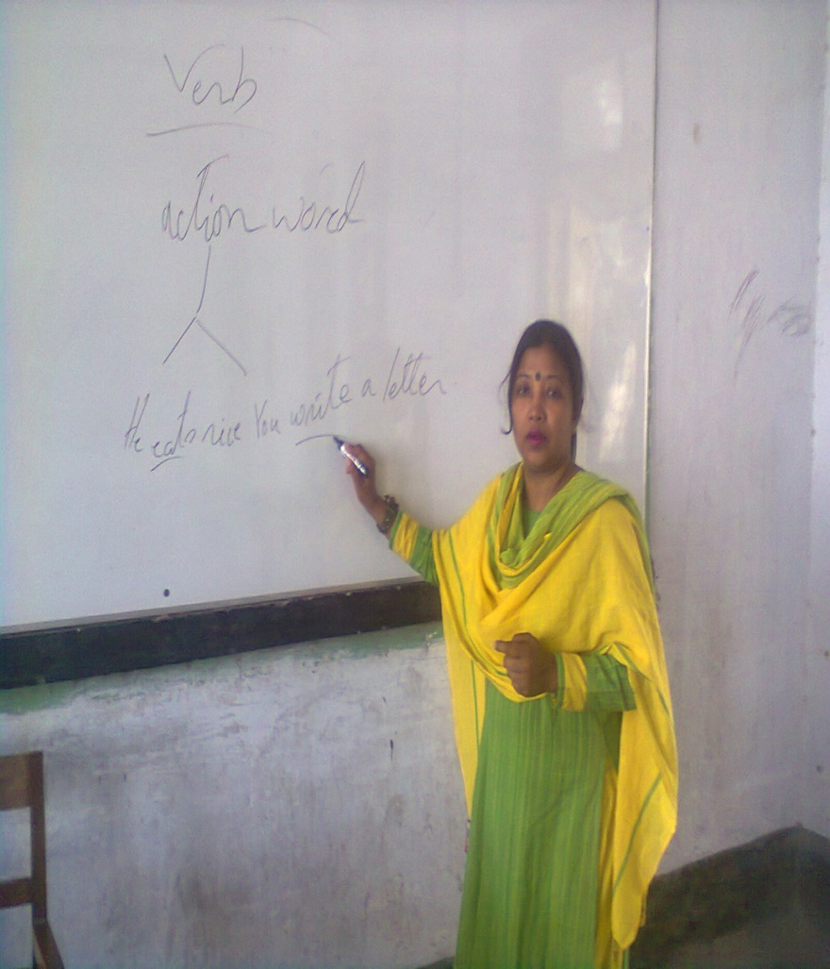
ME
ISMAT ARA MAMATAZ
ASSISTANT TEACHER(ENGLISH)
DHANMONDI GOVT.BOYS’HIGH SCHOOL
DHAKA

Slide 3
Welcome
To
My
grammar class

Slide 4
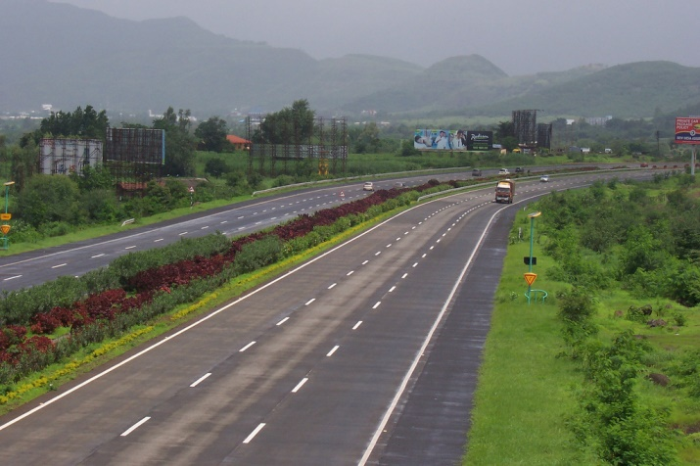
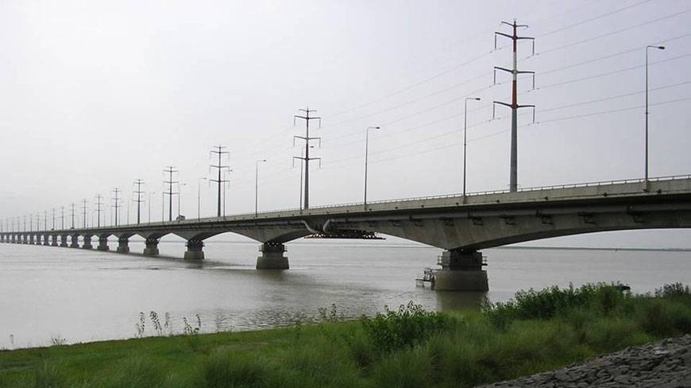
What do you see in the pictures?
,
If you want to cross a river
you need to use a bridge.
Notes:
The learners will be asked to say something on the pictures. After learners’ speech the teacher will announce the day’s topic.

Slide 5
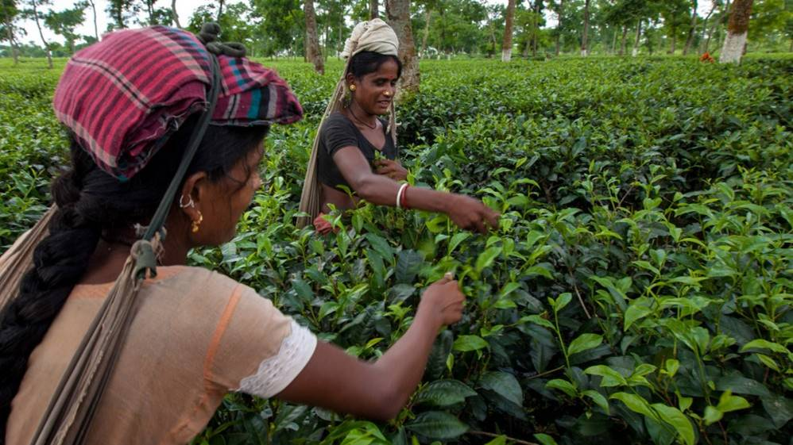
TODAY’S TOPIC
SENTENCE CONNECTORS
(LINKERS)

Slide 6
Learning outcomes
By the end of the lesson the learners will be able to
*make sentences using sentence connectors ( linkers)
*use sentence connectors in a passage listening to a text.
* develop a paragraph using sentence connectors.

Slide 7
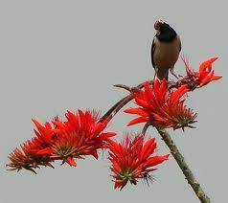
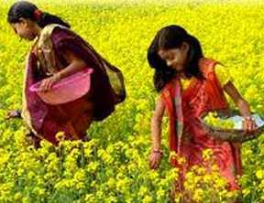
When it is spring , colourful flowers bloom.
Notes:
The learners are asked to maake more sentences with when.

Slide 8
. In addition to , you have lost the former one.
Are you okay ? I am deeply concerned about you. You have been depressed since you missed the new job interview.
Notes:
The learners will make more sentences with in addition to.

Slide 9
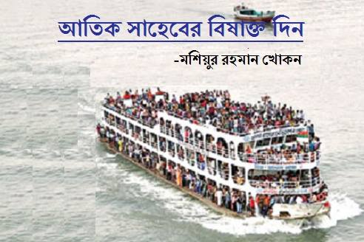
The launch was over crowded .
As a result, it may sink.
Notes:
The learners will be asked for making more sentences using the given linker.

Slide 10
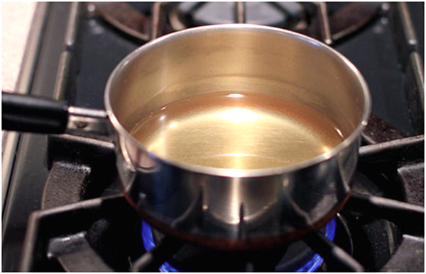
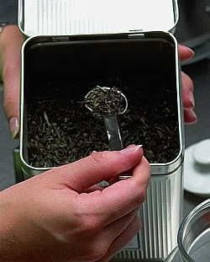
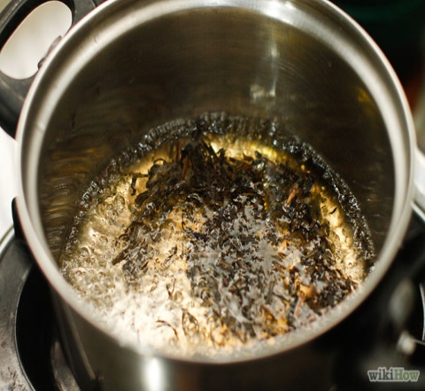
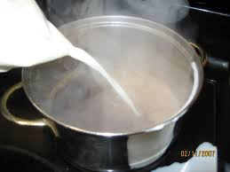
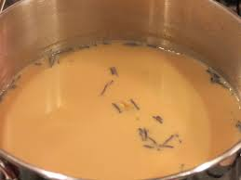
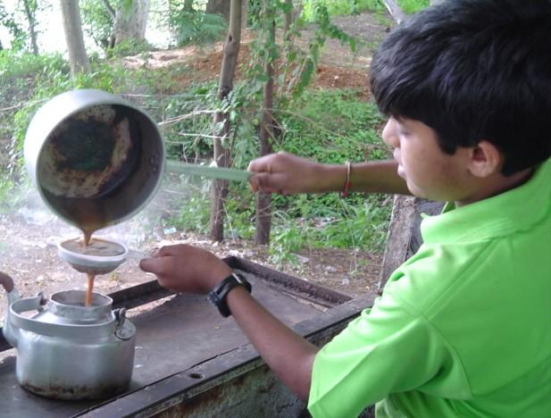
Discuss the pictures in pairs . Then develop a paragraph using the given clues.
Clues: At first, Then, After that,
Next, Afterward, later ,Finally

Slide 11
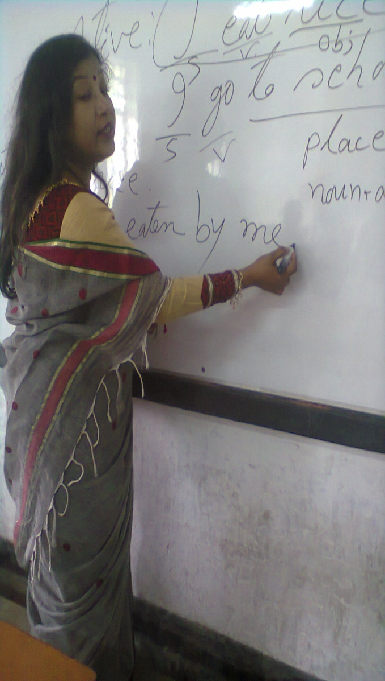
I couldn’t get my head around the Passive Voice. Anyway, I don’t think it’s important to use it all the time.
Notes:
The learners will be asked for making sentence or passage using more dismissal sentence connectors- any way, any how,at any rate

Slide 12
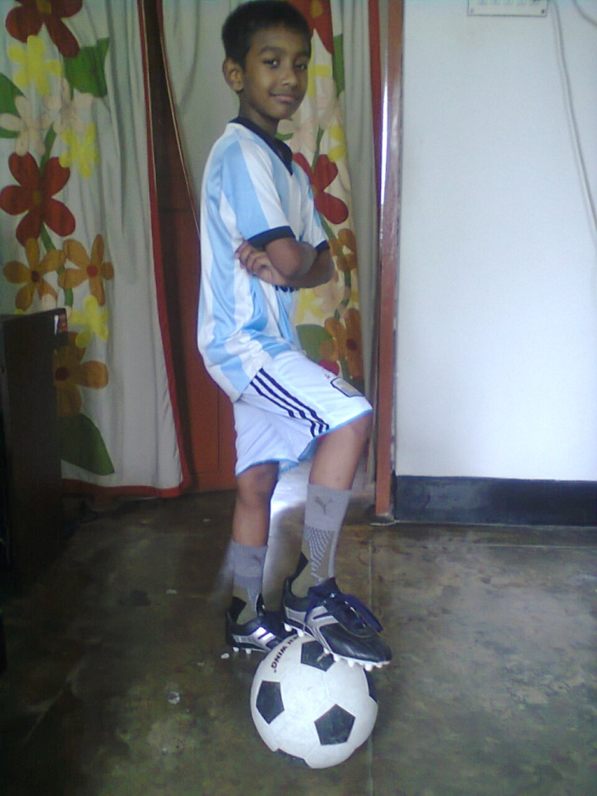
Nitol was in so much pain . He didn’t want to get up in the morning to go to school. Nevertheless, now he is ready to go to football practice as usual.

Slide 13
Yesterday I appeared at a sudden class test.The test was ridiculously easy ! I didn’t even study ,
but I will get a high score.

Slide 14
At first The bees collect honey from flowers.
After that they store them in the beehive.
Notes:
The learners will be asked for developing a sequence using the given connectors.

Slide 15
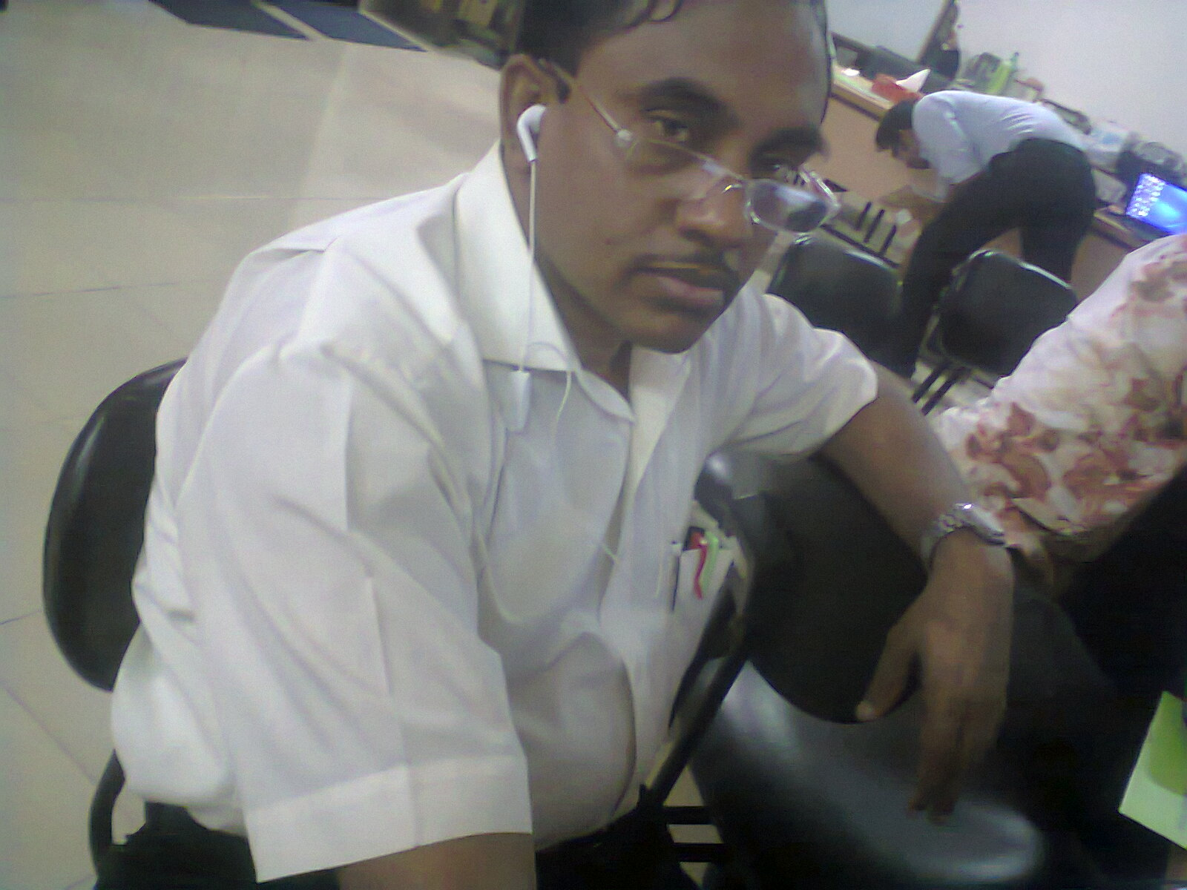
Mr. Hasan didn’t want to take a side in the argument. Instead, he put his headphones on and listened to some smooth Rabindra Sangeets.
Notes:
The learners will be asked for making sentences with the given connectors and with in any case, on the contrary and all the same.

Slide 16
At a glance Sentence Connectors:
‘Connectors’ are used to link large groups of words: phrases and sentences. You can also use them to connect paragraphs to give them coherence.
Sentence connectors are usually placed at the beginning of a sentence and may be categorized as follows:
Contrast, Similarity, Result, Sequence, Dismissal and order of Importance

Slide 17
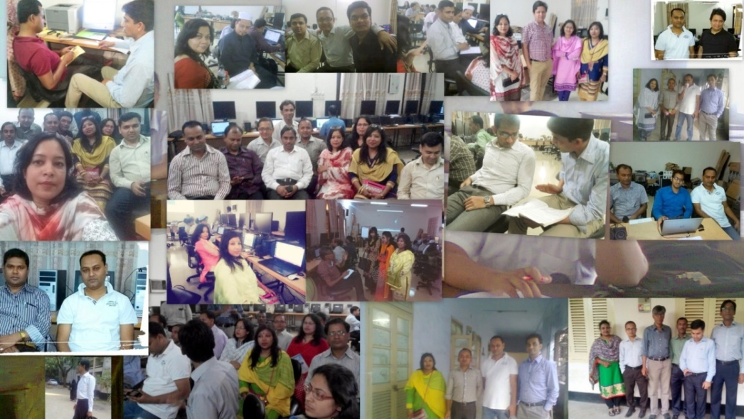
Audio
The government has taken steps to make our country Digital. a)…. every other sectors , education sector is going forward using ICT. In the institutions we are taking classes in the multimedia classrooms . b)…we, the teachers have to make digital contents for this purpose. c)…. most of the teachers have given training on making digital contents, all of them can not develop contents due to various types of barriers. d)…..considering all sides and facilities to fulfill this increasing demand of getting ready made contents, a group of model content developers has been selected by A2i . e)….. A2i is doing this job very successfully.
Notes:
The learners will be asked for listening to the text attentively. After that a gap filling task will be given. Like , So , Although, Therefore , and – the answers serially. If needed, the teacher may tell them the answers.

Slide 18
HOME WORK
Write a paragraph on
“How to open a Bank Account.”

Slide 19
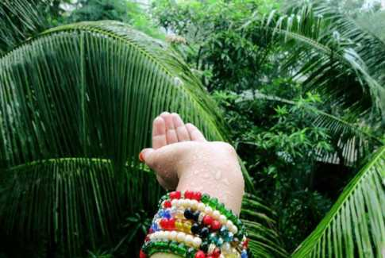
Thank You So Much

Slide 20
Acknowledgement
MoE, DSHE, NCTB & A2I respective officials
And the editors panel:
Mr. Ranjit Poddar, Associate Prof, TTC, Dhaka,
Mr. Md. Jahangir Hasan, Asst. Prof, TTC, Rangpur,
Urmila Khaled Asst. Prof, TTC, Dhaka.
Their direction, valuable suggestions and intensive supervision have enriched the model contents.

